Slide 1
JDBC Criteria API
Student: Uivari Radu-Iulian
Year: III

Slide 2
Table of contents
RowSet Interface
Capabilities of RowSet objects
Types of RowSet objects
Concreate example
References

Slide 3
1). RowSet Interface
A RowSet object holds tabular data in a way that is more easier to use and manipulate than a ResultSet
All RowSet objects are derived from ResultSet interface, thus adding more features to the ones provided by a ResultSet object, like: Properties and JavaBeans Notification Mechanism

Slide 4
2). Capabilities of RowSet objects
Properties: - fields that has corresponding setters and getters that describes the information a specific object encapsulates
JavaBeans Notification Mechanism: - objects are notified when special events occur. These events include: cursor movement, update/insertion/deletion of a row, a change in the entire RowSet object

Slide 5
3). Types of RowSet objects
There are two kinds of RowSet objects: Connected and Disconnected
Connected RowSet object: - uses a JDBC driver to connect to a data source and maintain its connection throughout its life span. (JdbcRowSet object)
Disconnected RowSet object:
- uses a connection only to read in the data or to write the data back to a data source. During its life span it functions independently and does not maintain a persistent connectin to the database. (CachedRowSet, WebRowSet, JoinedRowSet, FilteredRowSet objects)
- are serializable and lightweight, thus can be used to send data over the network
-has all capabilities of connected RowSet objects

Slide 6
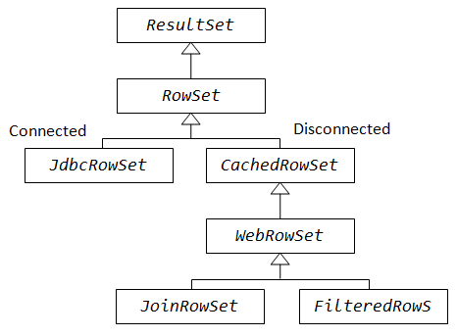
3.1). JdbcRowSet
It is simmilar to a RowSet object in the sense that it always need a connection to a data source, but it acts as wrapper for it because it transform it from non-scrollable and read-only object to a scrollabel and updatable one
RowSet classes

Slide 7
3.2). CachedRowSet
It provides all the basic capabilities a disconnected RowSet object can have (WebRowSet, JoinedRowSet and FilteredRowSet implements it). Its main function is that it caches the data retrive from a source in memory such that it can operate on it rather then mentaining a persistent connection to the data from the database
RowSet classes

Slide 8
3.3). WebRowSet
It can write itself an XML document and also can red an XML document that describes a WebRowSet object
RowSet classes

Slide 9
3.4). JoinedRowSet
Offer the possibility to perform SQL JOIN on some data without having to connect to a data source
RowSet classes

Slide 10
3.5). FilteredRowSet
Apply a filtering criteria in order to make only specific data visible. It is the equivalent of executing a query using the WHERE Clause on a RowSet object without being connected to a data source or having to use a query language
RowSet classes

Slide 11
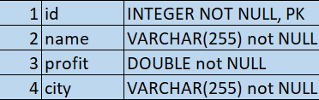
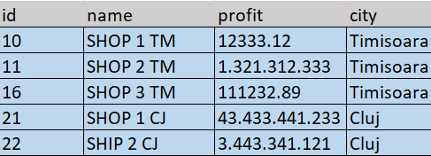
4). Concrete Example
Consider the following database scheme and its corresponding data stored in memory:
Databse scheme
Actual data

Slide 12
4). Concrete Example
Problem description: - we would like to filter the data based on their city (id in range [10, 19] implies city = Timisoara, id in range [20, 29] implies city = Cluj)
Soluton: - we make use of the FilteredRowSet object and implement a custom filter, called CityFilter, for retrieving the specific data that we want

Slide 13
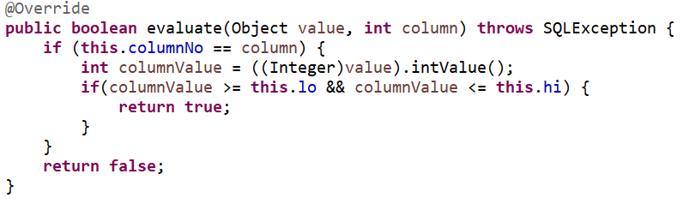
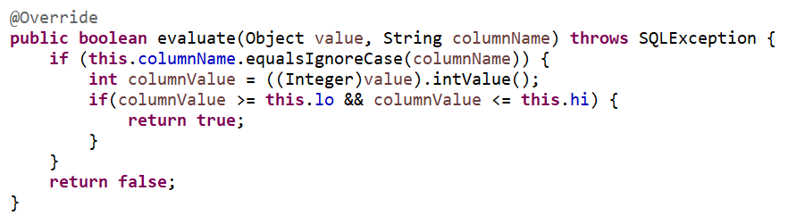
4). Concrete Example
The custom filter implementation needs to implement a method with diffrenet signatures provided by the Predicate Java Interface:
Evaluate using column index
Evaluate using column name

Slide 14
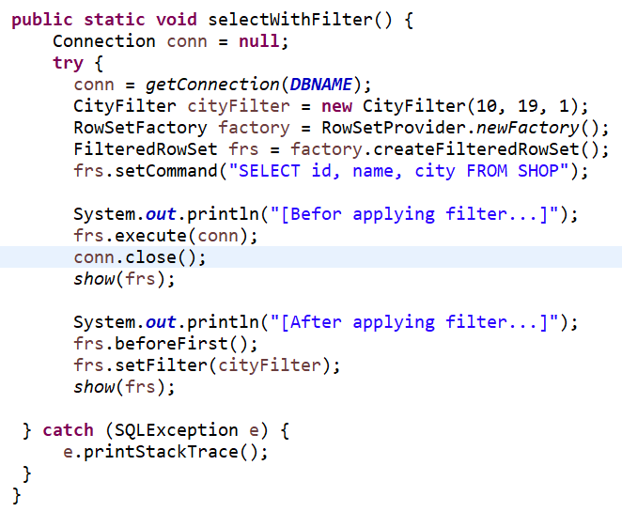
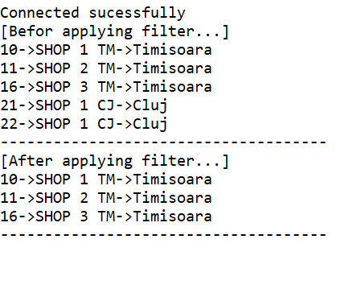
4). Concrete Example
The actual filtering is done by the following method:
Method definition
Method output after executioon

Slide 15
4). Concrete Example
You can find a complete implementation of the code here: https://github.com/radu-ux/JDBC-Criteria-API.git

Slide 16
5). References
https://blog.pavelsklenar.com/using-filteredrowset-simple-example/
https://www.developer.com/java/data/filtering-data-with-the-jdbc-rowset.html
https://www.baeldung.com/java-jdbc-rowset
https://docs.oracle.com/javase/tutorial/jdbc/basics/rowset.html

Slide 17
Thank for your time !

